Slide 1
Chapter 8
The Theory of NP-Completeness

Slide 2
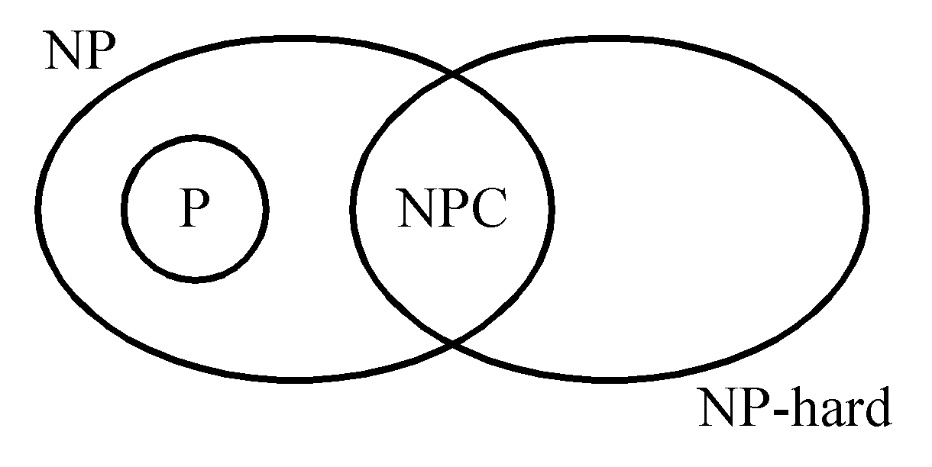
P: the class of problems which can be solved by a deterministic polynomial algorithm.
NP : the class of decision problem which can be solved by a non-deterministic polynomial algorithm.
NP-hard: the class of problems to which every NP problem reduces.
NP-complete (NPC): the class of problems which are NP-hard and belong to NP.

Slide 3
Some Concepts of NPC
Definition of reduction: Problem A reduces to problem B (A ∝ B) iff A can be solved by a deterministic polynomial time algorithm using a deterministic algorithm that solves B in polynomial time.
Up to now, none of the NPC problems can be solved by a deterministic polynomial time algorithm in the worst case.
There does not seem to be any polynomial time algorithm to solve the NPC problems.

Slide 4
The theory of NP-completeness always considers the worst case.
The lower bound of any NPC problem seems to be in the order of an exponential function.
Not all NP problems are difficult (e.g. the MST problem is an NP problem).
If A, B ∈ NPC, then A ∝ B and B ∝ A.
Theory of NP-completeness
If any NPC problem can be solved in polynomial time, then all NP problems can be solved in polynomial time (NP = P).

Slide 5
Decision Problems
The solution is simply “Yes” or “No”.
Optimization problems are more difficult.
e.g. the traveling salesperson problem
  Optimization version:
  Find the shortest tour
  Decision version:
  Is there a tour whose total length is less than or equal to a constant c ?

Slide 6
The Satisfiability Problem
The satisfiability problem
  A logical formula:
x₁ v x₂ v x₃
& - x₁
& - x₂
  the assignment :
x₁ ← F , x₂ ← F , x₃ ← T
  will make the above formula true.
(-x₁, -x₂ , x₃) represents x₁ ← F , x₂ ← F , x₃ ← T

Slide 7
If there is at least one assignment which satisfies a formula, then we say that this formula is satisfiable; otherwise, it is unsatisfiable.
An unsatisfiable formula:
  x₁ v x₂
  & x₁ v -x₂
  & -x₁ v x₂
  & -x₁ v -x₂

Slide 8
Definition of the satisfiability problem: Given a Boolean formula, determine whether this formula is satisfiable or not.
A literal: x_{i} or -x_{i}
A clause: x₁ v x₂ v -x₃ ≡ C_{i}
A formula: conjunctive normal form
C₁& C₂ & … & C_{m}

Slide 9
The Resolution Principle
Resolution Principle
C₁ : x₁ v x₂
C₂ : -x₁ v x₃
⇒ C₃ : x₂ v x₃
From C₁ & C₂, we can obtain C₃, and C₃ can be added to the formula.
We have a new formula:
C₁ & C₂ & C₃.
x₁ | x₂ | x₃ | C₁ & C₂ | C₃
0 | 0 | 0 | 0 | 0
0 | 0 | 1 | 0 | 1
0 | 1 | 0 | 1 | 1
0 | 1 | 1 | 1 | 1
1 | 0 | 0 | 0 | 0
1 | 0 | 1 | 1 | 1
1 | 1 | 0 | 0 | 1
1 | 1 | 1 | 1 | 1

Slide 10
Another example of resolution principle
C₁ : -x₁ v -x₂ v x₃
C₂ : x₁ v x₄
⇒ C₃ : -x₂ v x₃ v x₄
If no new clauses can be deduced, then it is satisfiable.
-x₁ v -x₂ v x₃ (1)
x₁ (2)
x₂ (3)
(1) & (2) -x₂ v x₃ (4)
(4) & (3) x₃ (5)
(1) & (3) -x₁ v x₃ (6)
Thus this set of clauses is satisfiable.

Slide 11
If an empty clause is deduced, then it is unsatisfiable.
- x₁ v -x₂ v x₃ (1)
x₁ v -x₂ (2)
x₂ (3)
- x₃ (4)
⇓ deduce
(1) & (2) -x₂ v x₃ (5)
(4) & (5) -x₂ (6)
(6) & (3) □ (7)
Not satisfiable.

Slide 12
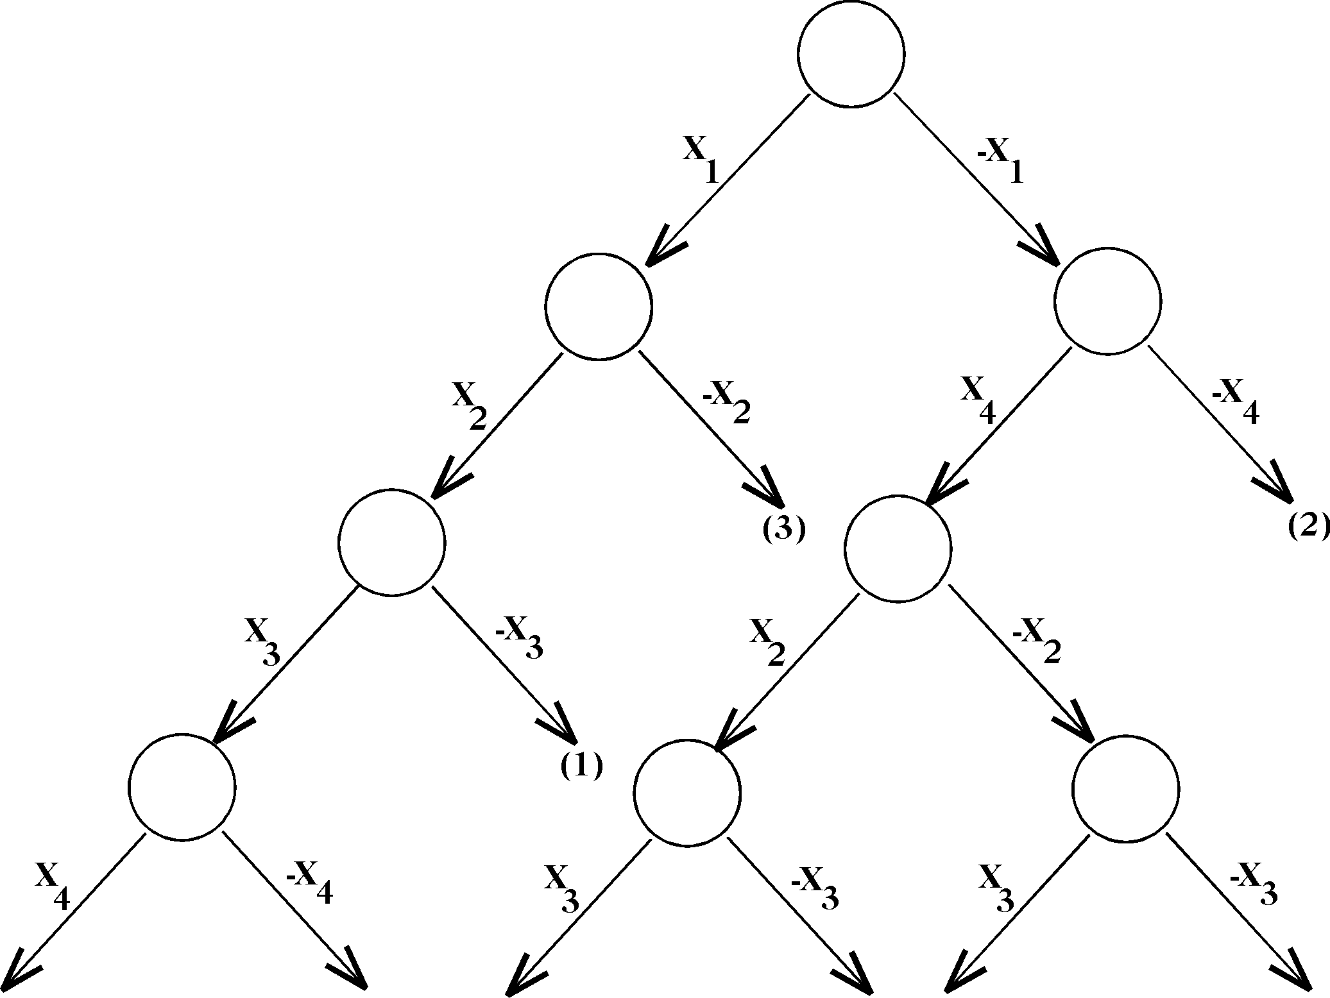
-x1 ∨ -x2 ∨ x3 (1)
x1 ∨ x4 (2)
x2 ∨ -x1 . (3)
A semantic tree.
Satisfiable

Slide 13
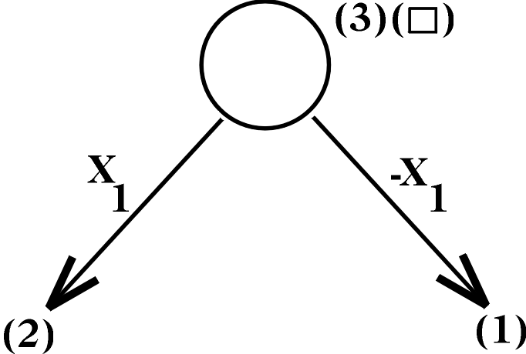
x1 (1)
-x1 (2)
A semantic tree.
Unsatisfiable

Slide 14
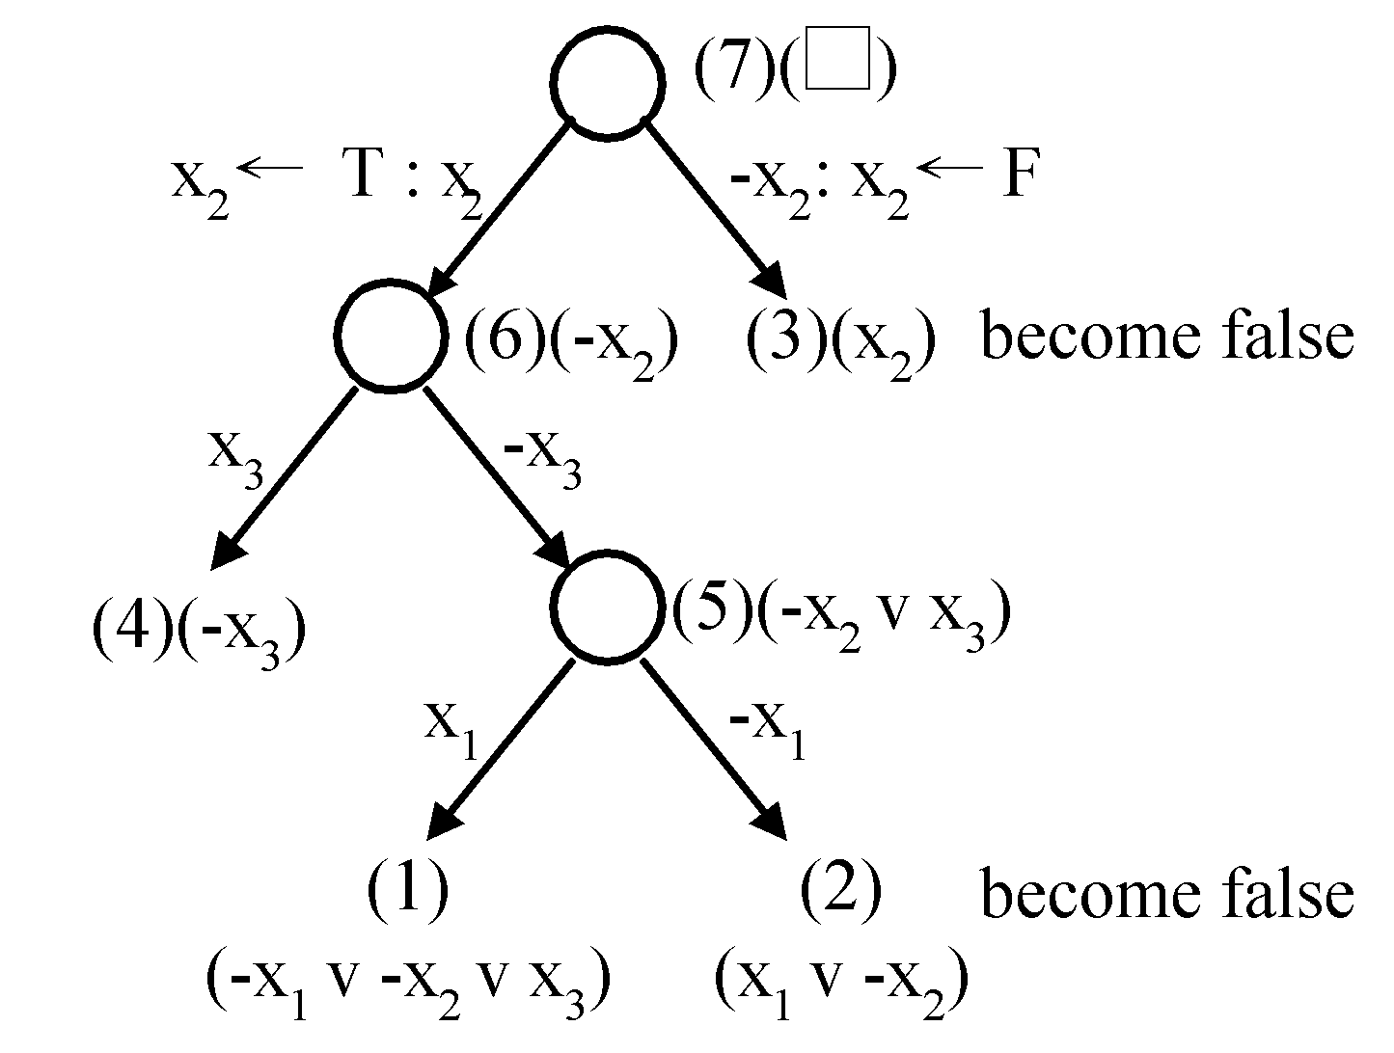
In a semantic tree, each path from the root to a leaf node represents a class of assignments.
If each leaf node is attached with a clause, then it is unsatisfiable.
Unsatisfiable

Slide 15
Nondeterministic Algorithms
A nondeterministic algorithm consists of
phase 1: guessing and phase 2: checking
If the checking phase of a nondeterministic algorithm is of polynomial time complexity, then this algorithm is called an NP (nondeterministic polynomial) algorithm.
NP problems: (must be decision problems)
  e.g. searching
  MST
    sorting
    satisfiability problem (SAT)
    traveling salesperson problem (TSP)

Slide 16
Decision Problems
Decision version of sorting:
Given a₁, a₂,…, a_{n} and c, is there a permutation of a_{i}′s ( a₁′, a₂′ , … ,a_{n}′ ) such that∣a₂′–a₁′∣+∣a₃′–a₂′∣+ … +∣a_{n}′–a_{n-1}′∣＜ c ?
Not all decision problems are NP problems.
  E.g. halting problem:
    Given a program with a certain input data, will the program terminate or not?
    NP-hard
    Undecidable

Slide 17
Guessing and Checking
[Horowitz 1998]
Choice(S): arbitrarily chooses one of the elements in set S
Failure: an unsuccessful completion
Success: a successful completion
Nonderministic searching algorithm:
j ← choice(1 : n) /* guessing */
if A(j) = x then success /* checking */
else failure

Slide 18
A nondeterministic algorithm terminates unsuccessfully if there exists no set of choices leading to a success completion.
The time required for choice(1 : n) is O(1).

Slide 19
Cook’s Theorem
NP = P if the satisfiability problem is a P problem.
SAT is NP-complete.
It was the first NP-complete problem proved.
Every NP problem reduces to SAT.

Slide 20
Transforming Search to SAT
Does there exist a number in { x(1), x(2), …, x(n) }, which is equal to 7?
Assume n = 2.
nondeterministic algorithm:
i = choice(1,2)
if x(i)=7 then SUCCESS
else FAILURE

Slide 21
  i=1 v i=2
  & i=1 → i≠2
  & i=2 → i≠1
  & x(1)=7 & i=1 → SUCCESS
  & x(2)=7 & i=2 → SUCCESS
  & x(1)≠7 & i=1 → FAILURE
  & x(2)≠7 & i=2 → FAILURE
  & FAILURE → -SUCCESS
  & SUCCESS (Guarantees a successful termination)
  & x(1)=7 (Input data)
  & x(2)≠7

Slide 22
CNF (conjunctive normal form) :
  i=1 v i=2 (1)
  i≠1 v i≠2 (2)
  x(1)≠7 v i≠1 v SUCCESS (3)
  x(2)≠7 v i≠2 v SUCCESS (4)
  x(1)=7 v i≠1 v FAILURE (5)
  x(2)=7 v i≠2 v FAILURE (6)
  -FAILURE v -SUCCESS (7)
  SUCCESS (8)
  x(1)=7 (9)
  x(2)≠7 (10)

Slide 23
Satisfiable with the following assignment:
  i=1 satisfying (1)
  i≠2 satisfying (2), (4) and (6)
  SUCCESS satisfying (3), (4) and (8)
  −FAILURE satisfying (7)
  x(1)=7 satisfying (5) and (9)
  x(2)≠7 satisfying (4) and (10)

Slide 24
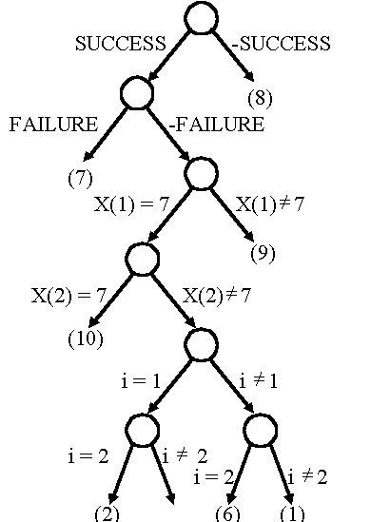
The semantic tree

Slide 25
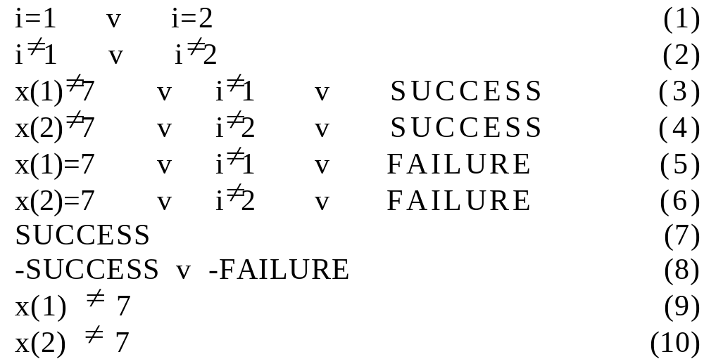
Searching for 7, but x(1)≠7, x(2)≠7
CNF (conjunctive normal form):

Slide 26
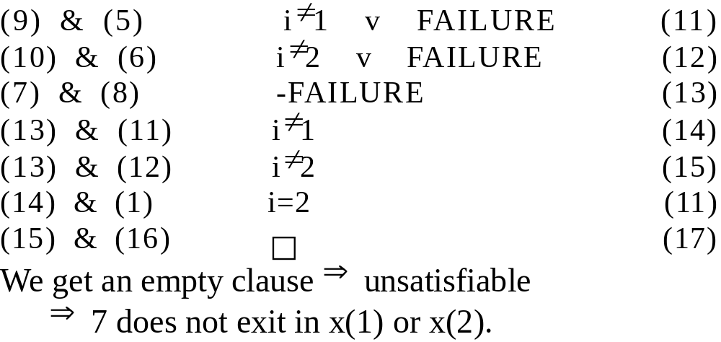
Apply resolution principle:

Slide 27
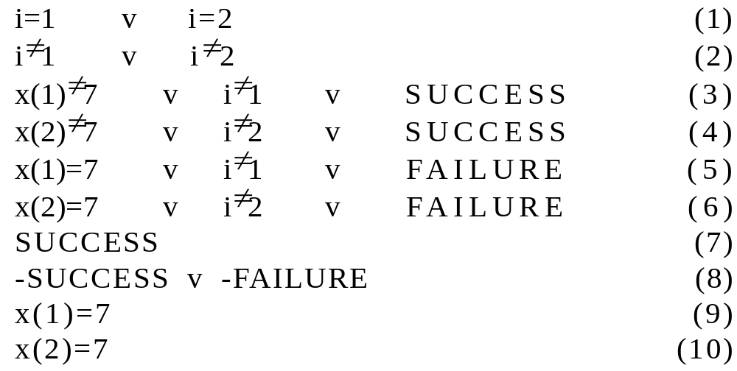
Searching for 7, where x(1)=7, x(2)=7
CNF:

Slide 28
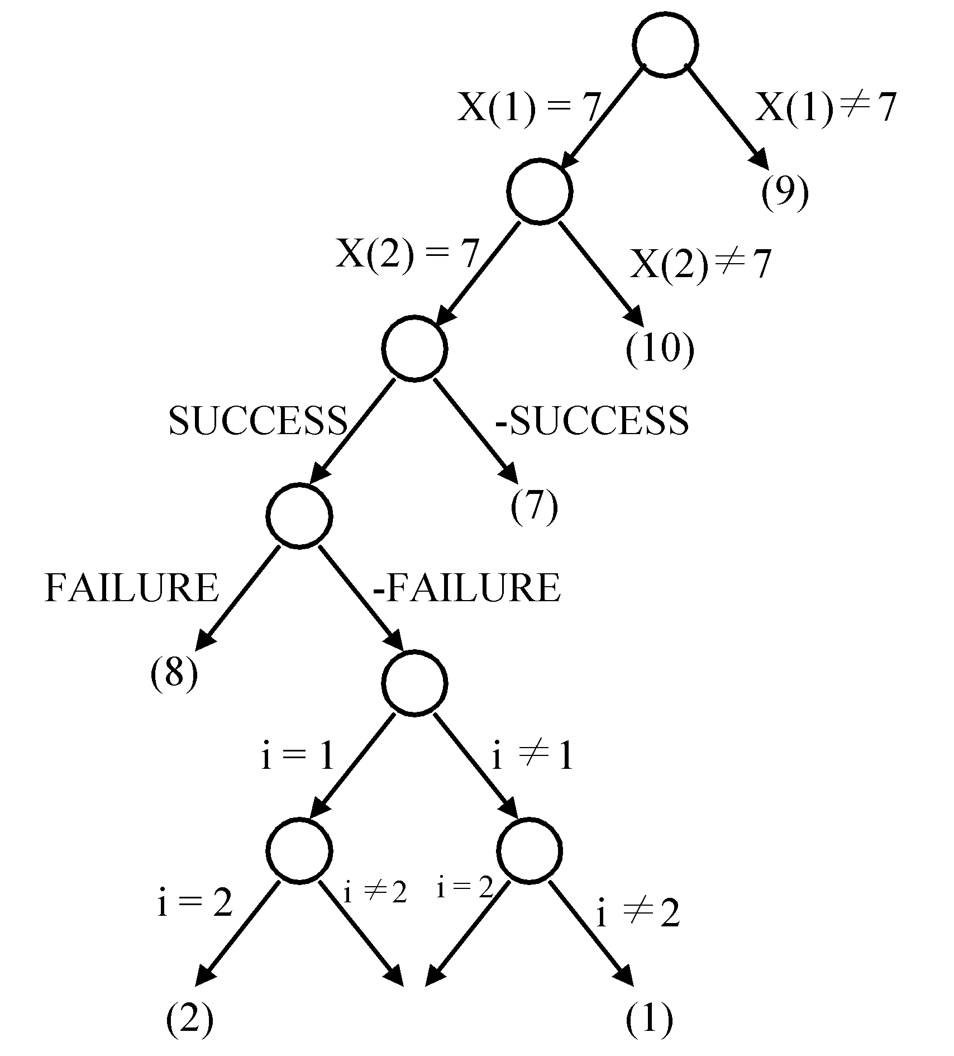
The semantic tree
It implies that both assignments (i = 1, i = 2) satisfy the clauses.

Slide 29
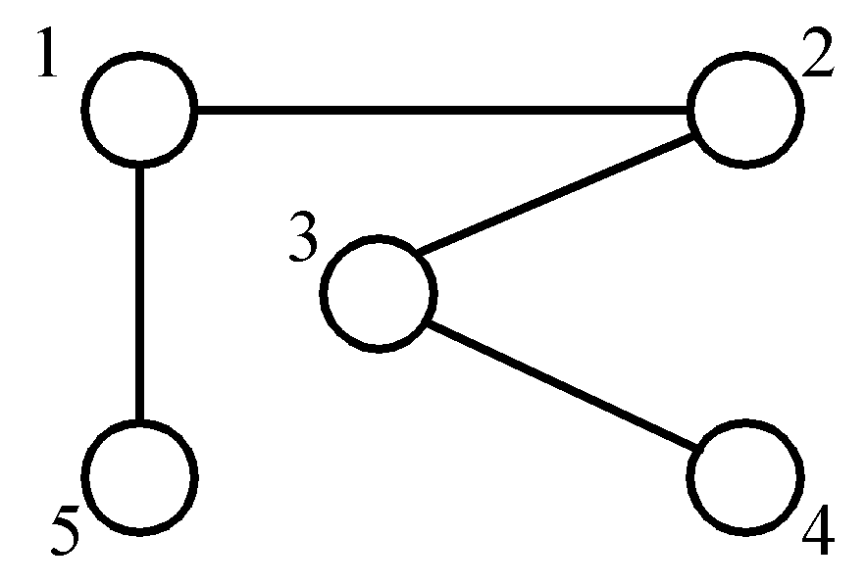
The Node Cover Problem
Def: Given a graph G = (V, E), S is the node cover of G if S ⊆ V and for ever edge (u, v) ∈ E, (u,v) is incident to a node in S.
node cover:
{1, 3}
{5, 2, 4}
Decision problem: ∃ S ∋ | S | ≤ K ?

Slide 30
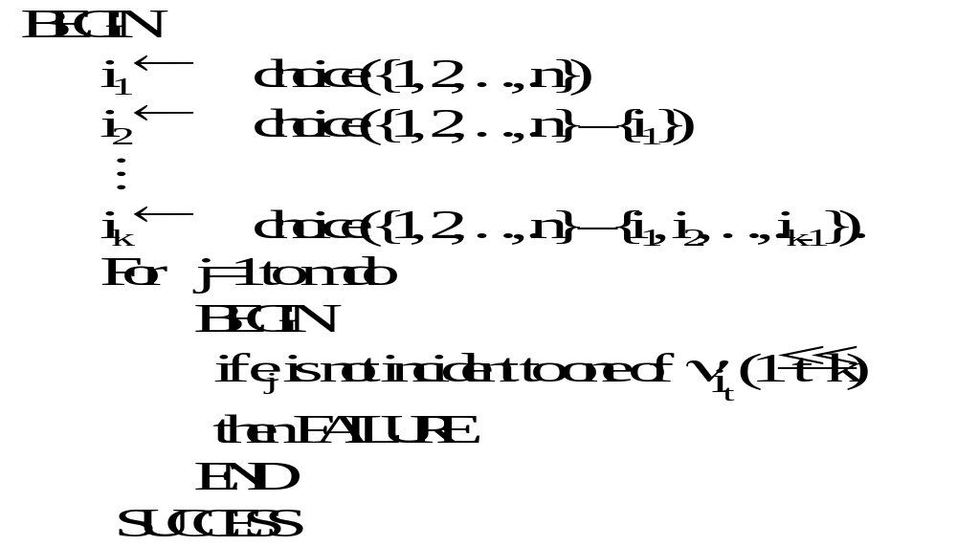
Transforming the Node Cover Problem to SAT

Slide 31
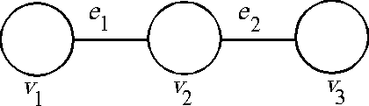
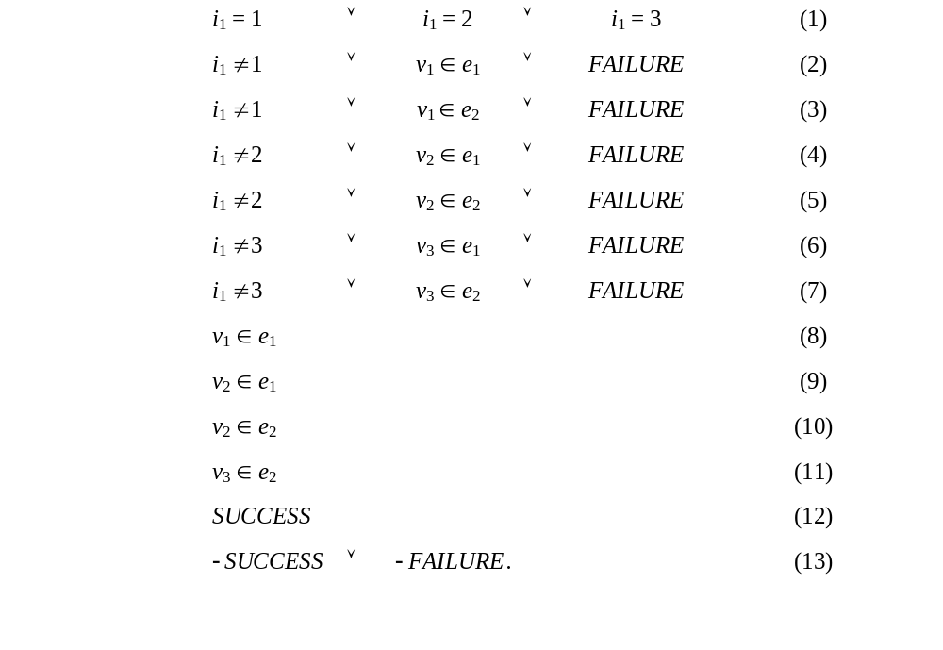
A Graph

Slide 32
SAT is NP-complete
(1) SAT is an NP problem.
(2) SAT is NP-hard:
  Every NP problem can be transformed in polynomial time to SAT such that SAT is satisfiable if and only if the answer for the original NP problem is “YES”.
  That is, every NP problem ∝ SAT .
By (1) and (2), SAT is NP-complete.

Slide 33
Proof of NP-Completeness
To show that any problem A is NP-complete:
(I) Prove that A is an NP problem.
(II) Prove that ∃ B ∈ NPC, B ∝ A.
⇒ A ∈ NPC.
Why?

Slide 34
3-Satisfiability Problem (3-SAT)
Def: Each clause contains exactly three literals.
(I) 3-SAT is an NP problem (obviously)
(II) SAT ∝ 3-SAT
Proof:
  (1) One literal L₁ in a clause in SAT:
    In 3-SAT:
L₁ v y₁ v y₂
L₁ v -y₁ v y₂
L₁ v y₁ v -y₂
L₁ v -y₁ v -y₂

Slide 35
  (2) Two literals L₁, L₂ in a clause in SAT:
  In 3-SAT:
  L₁ v L₂ v y₁
  L₁ v L₂ v -y₁
  (3) Three literals in a clause: remain unchanged.
  (4) More than 3 literals L₁, L₂, …, L_{k} in a clause:
  in 3-SAT:
  L₁ v L₂ v y₁
  L₃ v -y₁ v y₂
  
  L_{k-2} v -y_{k-4} v y_{k-3}
  L_{k-1} v L_{k} v -y_{k-3}

Slide 36
Example of Transforming a 3-SAT
Instance to an SAT Instance
An instance S in SAT:
  x₁ v x₂
  -x₃
  x₁ v -x₂ v x₃ v -x₄ v x₅
The instance S′ in 3-SAT:
  x₁ v x₂ v y₁
  x₁ v x₂ v -y₁
  -x₃ v y₂ v y₃
  -x₃ v -y₂ v y₃
  -x₃ v y₂ v -y₃
  -x₃ v -y₂ v -y₃
  x₁ v -x₂ v y₄
  x₃ v -y₄ v y₅
  -x₄ v x₅ v -y₅
SAT ^{transform} 3-SAT
S S′

Slide 37
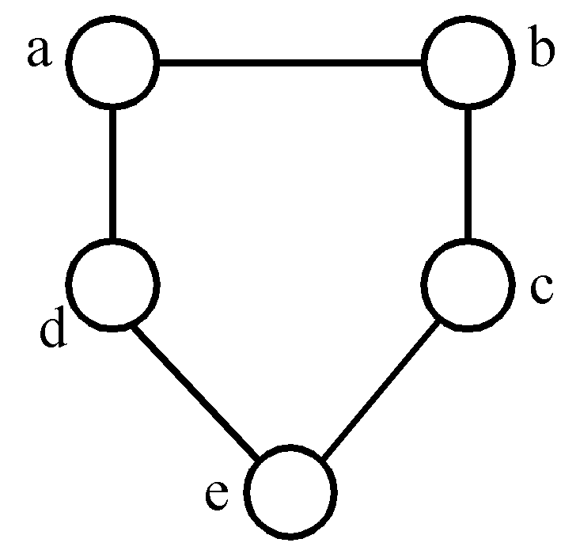
Chromatic Number Decision Problem (CN)
Def: A coloring of a graph G = (V, E) is a function f: V → { 1, 2, 3,…, k } such that if (u, v) ∈ E, then f(u)≠f(v). The CN problem is to determine if G has a coloring for k.
E.g.
<Theorem> Satisfiability with at most 3 literals per clause (SATY) ∝ CN.
3-colorable
f(a)=1, f(b)=2, f(c)=1
f(d)=2, f(e)=3

Slide 38
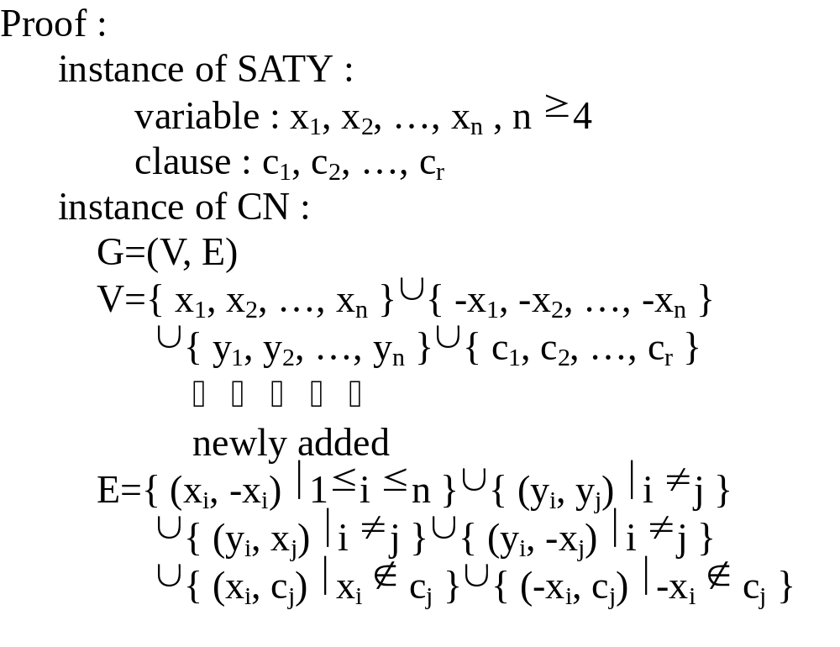
SATY ∝ CN

Slide 39
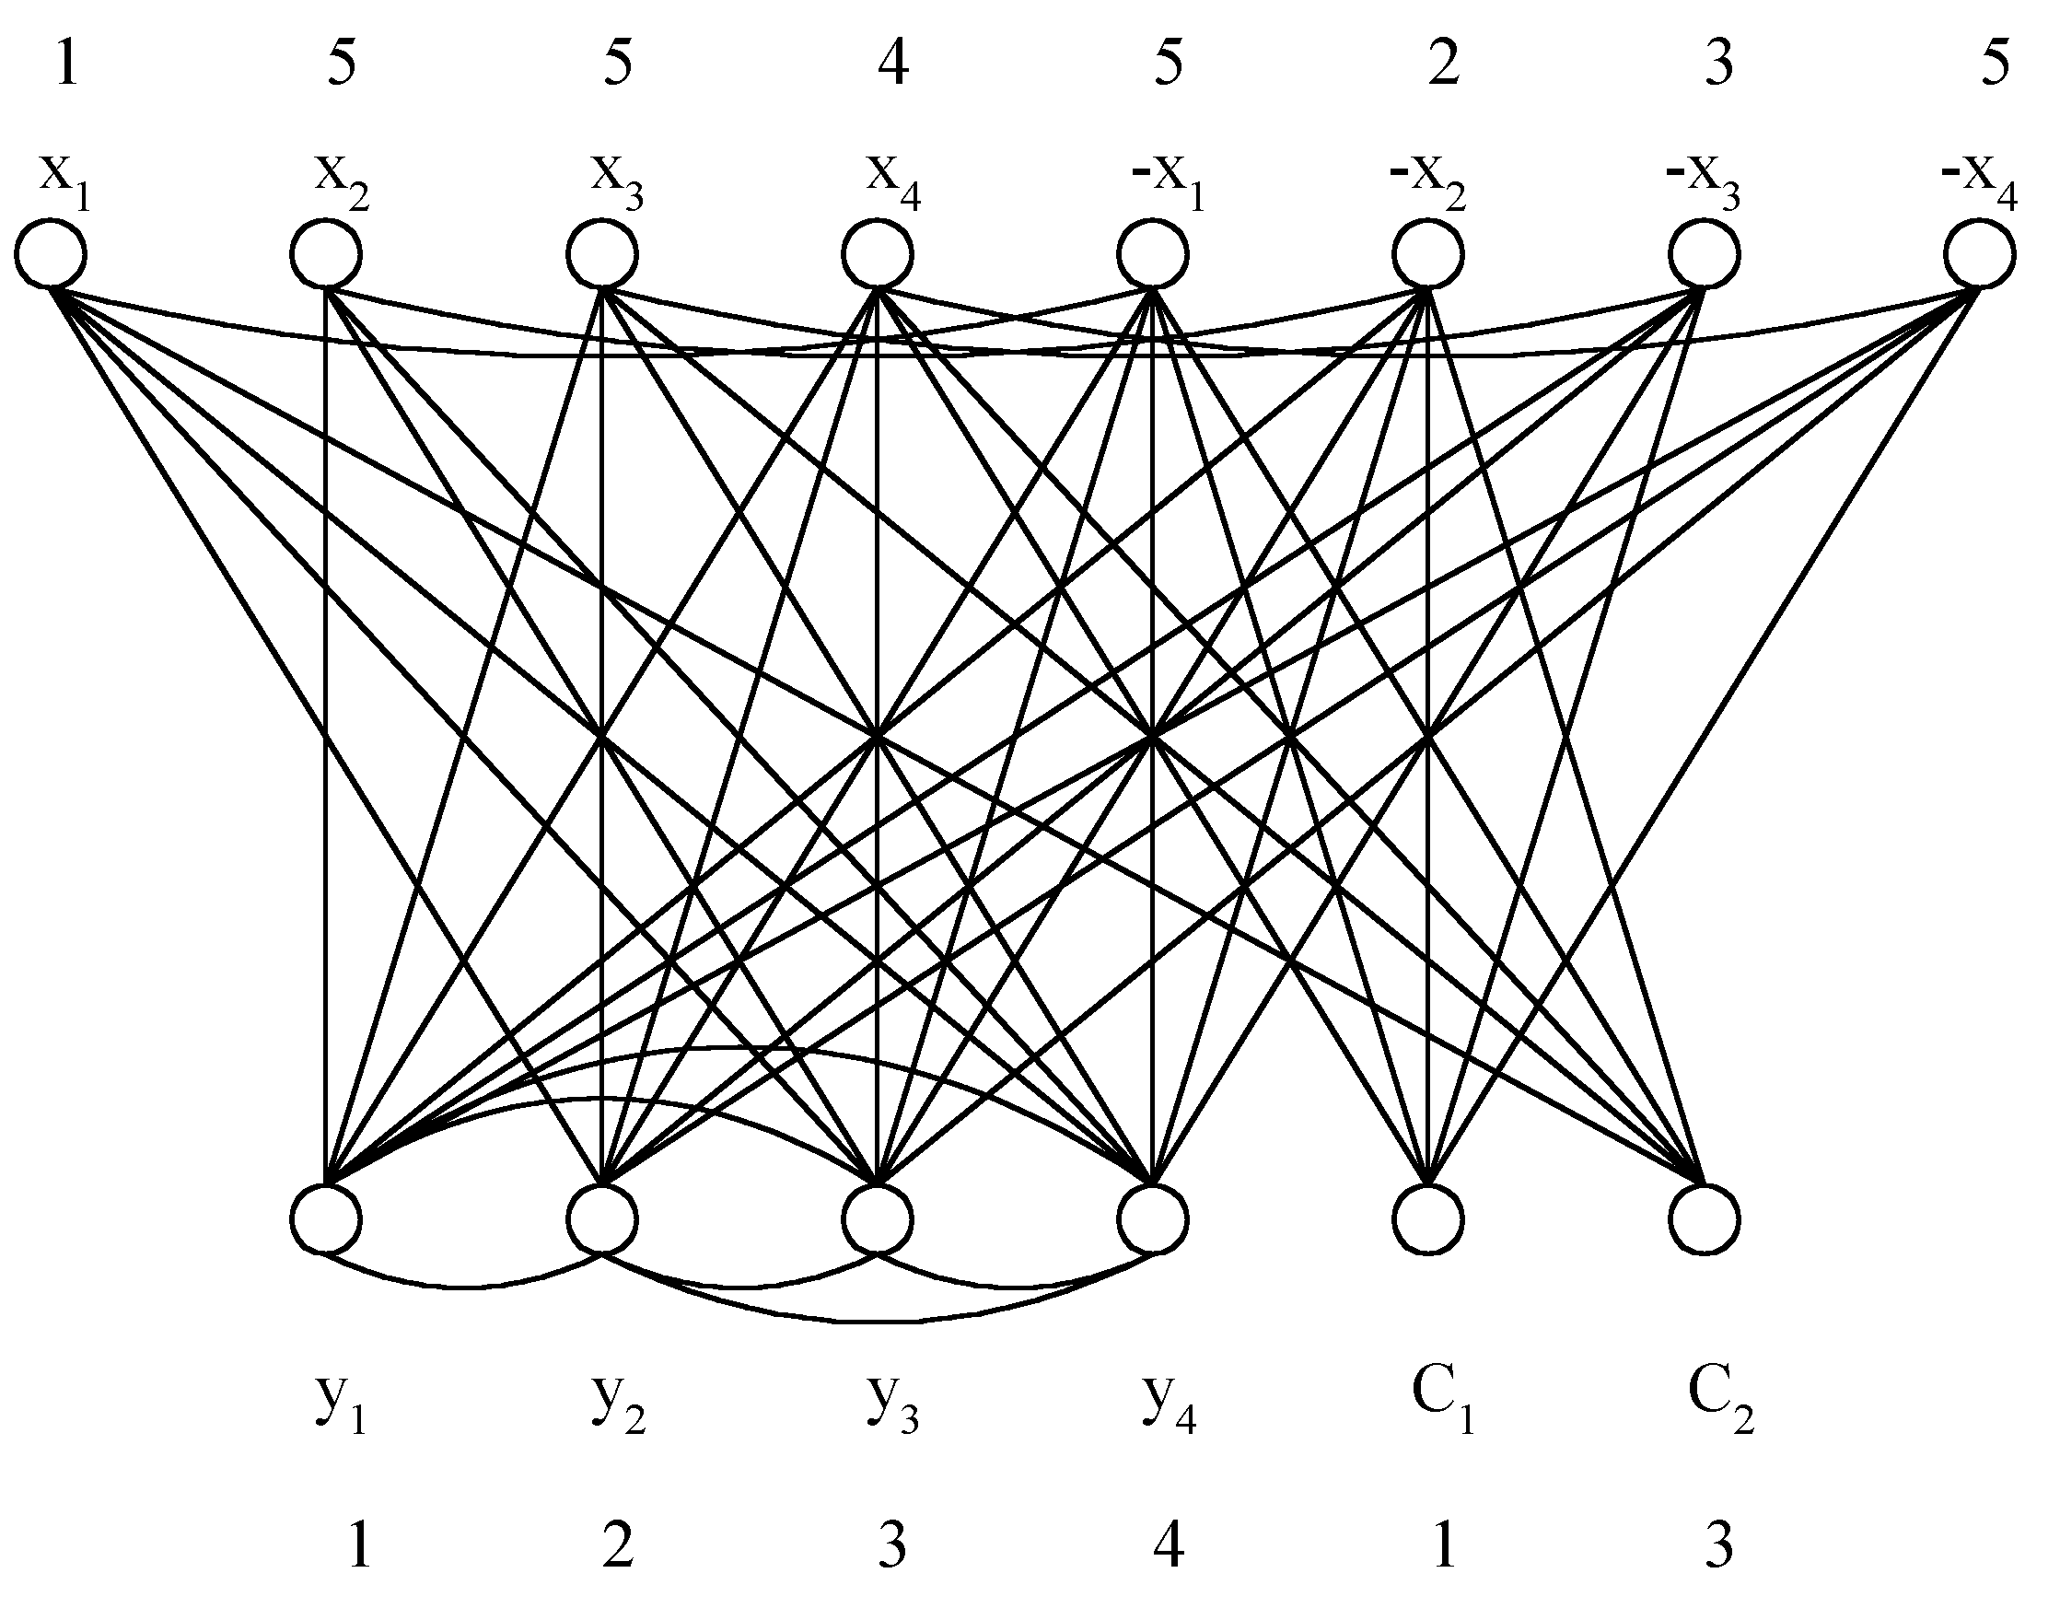
Example of SATY ∝ CN
x₁ v x₂ v x₃ (1)
-x₃ v -x₄ v x₂ (2)
⇓
True assignment:
x₁=T
x₂=F
x₃=F
x₄=T

Slide 40



Set Cover Decision Problem
Def: F = { S₁, S₂, …, S_{k} }
S_{i} = { u₁, u₂, …, u_{n} }
T is a set cover of F if T ⊆ F and S_{i} = S_{i}
The set cover decision problem is to determine if F has a cover T containing no more than c sets.
Example: c=3.
F = {(a₁, a₃), (a₂, a₄), (a₂, a₃), (a₄), (a₁, a₃ , a₄)}
s₁ s₂ s₃ s₄ s₅
T = { s₁, s₃, s₄ } set cover
T = { s₁, s₂ } another set cover

Slide 41
Exact Cover Problem
Def: To determine if F has an exact cover T, which is a cover of F and the sets in T are pairwise disjoint.
<Theorem> CN ∝ exact cover
(No proof here.)

Slide 42
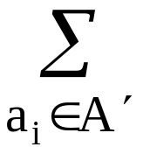
Sum of Subsets Problem
Def: A set of positive numbers A = { a₁, a₂, …, a_{n} }
  a constant C
  Determine if ∃ A′ ⊆ A ∋ a_{i} = C
e.g. A = { 7, 5, 19, 1, 12, 8, 14 }
  C = 21, A′ = { 7, 14 }
  C = 11, no solution
<Theorem> Exact cover ∝ sum of subsets.

Slide 43
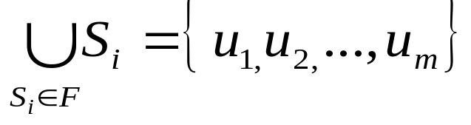
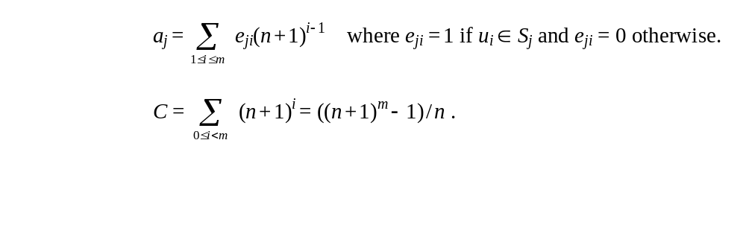
Exact Cover ∝ Sum of Subsets
Proof:
Instance of exact cover:
F = { S₁, S₂, …, S_{n} }
Instance of sum of subsets:
A = { a₁, a₂, …, a_{n} } where

Slide 44
Partition Problem
Def: Given a set of positive numbers A = { a₁,a₂,…,a_{n} },
determine if ∃ a partition P, ∋ ∑a_{i} = ∑a_{i}
i∈p i∉p
e.g. A = {3, 6, 1, 9, 4, 11}
partition: {3, 1, 9, 4} and {6, 11}
<Theorem> sum of subsets ∝ partition

Slide 45
Bin Packing Problem
Def: n items, each of size c_{i} , c_{i} > 0, a positive number k and bin capacity C,
determine if we can assign the items into k bins such that the sum of c_{i}’s assigned to each bin does not exceed C.
<Theorem> partition ∝ bin packing.

Slide 46
VLSI Discrete Layout Problem
Given: n rectangles, each with height h_{i} (integer)
width w_{i} and an area A, determine if there
is a placement of the n rectangles within A
according to the following rules:
  Boundaries of rectangles are parallel to x axis or y axis.
  Corners of rectangles lie on integer points.
  No two rectangles overlap.
  Two rectangles are separated by at least a unit distance.
  (See the figure on the next page.)

Slide 47
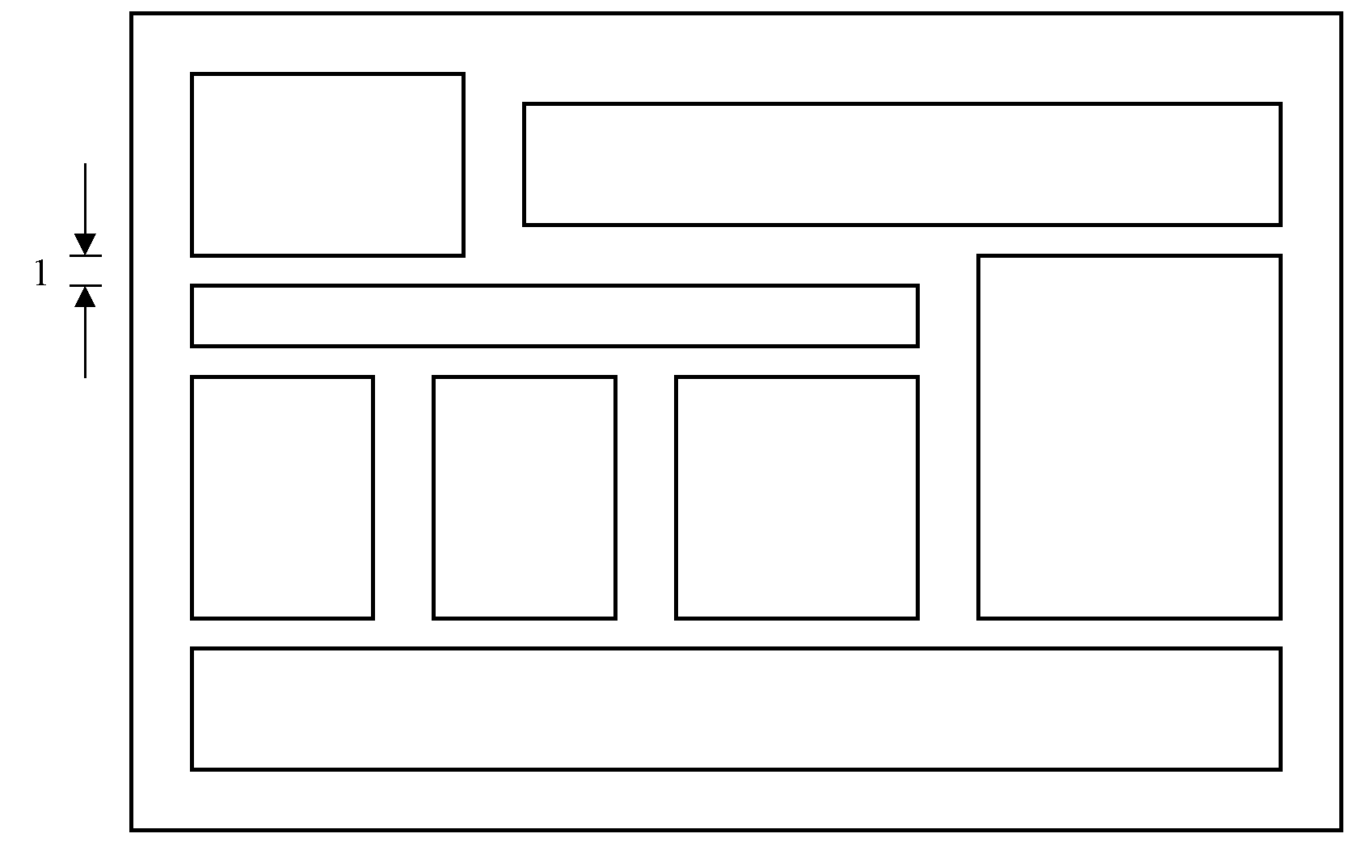
A Successful Placement
<Theorem> bin packing ∝ VLSI discrete layout.

